Slide 1
Unit 3

Slide 2
Pulse modulation.
Pulse modulation is further divided into
Pulse analog and
Pulse digital modulation.
The Pulse analog modulation techniques are mainly classified into
Pulse Amplitude Modulation,
Pulse Duration Modulation/Pulse Width Modulation, and
Pulse Position Modulation.
Pulse Analog Modulation is discrete in time because of sampling but some characteristic feature of each pulse is varied in continuous manner.
Pulse Digital modulation is discrete amplitude and discrete time representation of signal. This is achieved by sampling quantization and coding of analog signal.

Slide 3
Advantage of Pulse Modulation
(i) Transmitted power is no longer continuous as in CW Modulation, but pulsed in nature.
(ii) The time interval between pulse can be filled with sample values from other messages, this permits the transmission of number of messages using a single channel.

Slide 4
Pulse Amplitude Modulation
Pulse Amplitude Modulation (PAM) is an analog modulating scheme in which the amplitude of the pulse carrier varies proportional to the instantaneous amplitude of the message signal.
The pulse amplitude modulated signal, will follow the amplitude of the original signal, as the signal traces out the path of the whole wave.
Methods of PAM generation
In natural PAM, a signal sampled at the Nyquist rate is reconstructed, by passing it through an efficient Low Pass Frequency (LPF) with exact cutoff frequency
Flat-top sampling is the process in which sampled signal can be represented in pulses for which the amplitude of the signal cannot be changed with respect to the analog signal, to be sampled. The tops of amplitude remain flat.

Slide 5
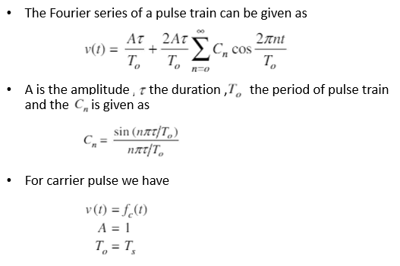
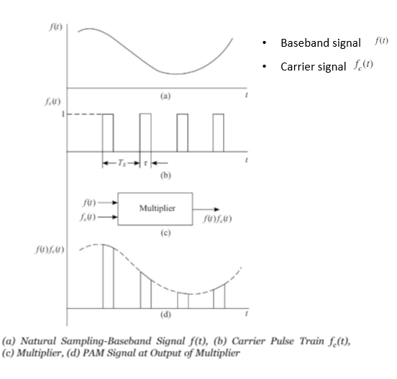
Natural Sampling
For a PAM signal produced with natural sampling, the sampled signal follows the waveform of the input signal during the time that each sample is taken.

Slide 6
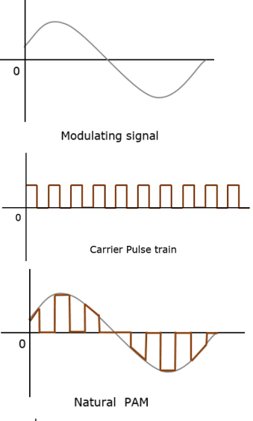
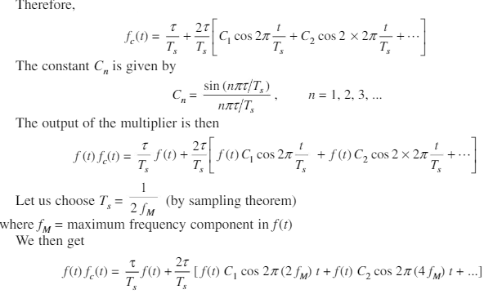
Natural Sampling
For a PAM signal produced with natural sampling, the sampled signal follows the waveform of the input signal during the time that each sample is taken.

Slide 7
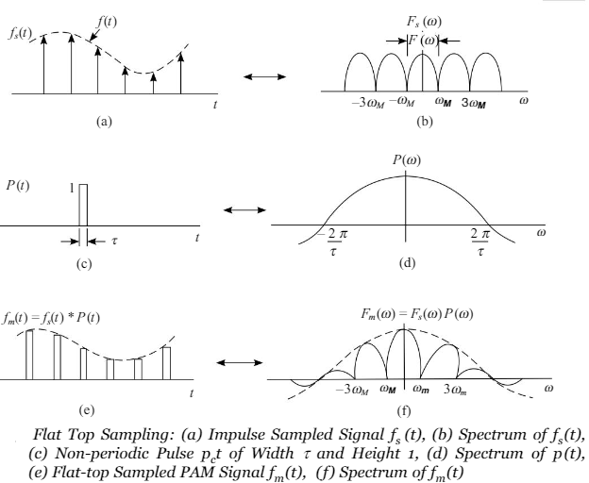
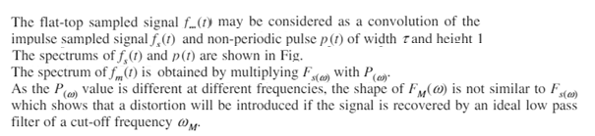
Flat Top Sampling
Flat-top sampling, produces pulses whose amplitude remains fixed during the sampling time. The amplitude value of the pulse depends on the amplitude of the input signal at the time of sampling.

Slide 8
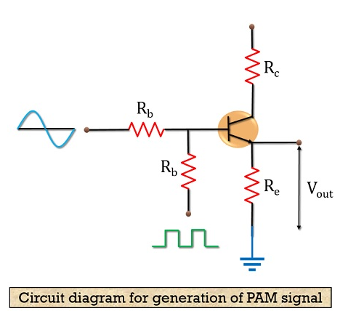
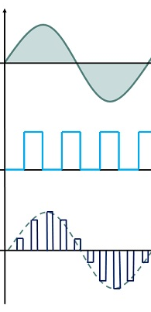
PAM Modulator
Flat-top sampling, produces pulses whose amplitude remains fixed during the sampling time. The amplitude value of the pulse depends on the amplitude of the input signal at the time of sampling.
The circuit is also known as emitter follower as the output is received from the emitter terminal of the transistor.
The rectangular pulse is applied to the transistor along with the message signal. When the peak of the pulse is high, it causes the transistor to operate in the saturation region. Thus, it behaves as a short circuit, allowing the analog signal to reach the output.
However, in case of the low peak of the rectangular pulse, the transistor operates in the cut-off region. Resultantly, it starts behaving as an open circuit and blocks the signal transmission.
In this way, a pulse amplitude modulated signal is transmitted.

Slide 9
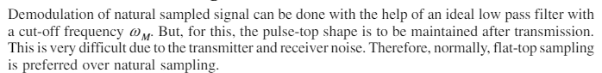
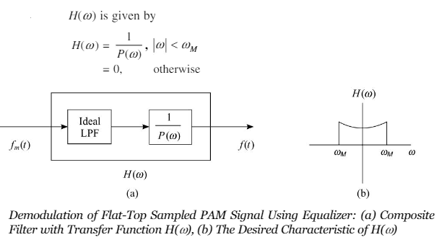
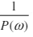
PAM Demodulation
Demodulation with equalizer
PAM signal sampled at Nyquist rate can be reconstructed at the receiver end , by passing it through an efficient Low Pass Filter (LPF) with exact cut off frequency of fs/2. This is known as Reconstruction or Interpolation Filter.
The flat top signal is passed through the ideal low pass filter ,the spectrum of the output is
The filter with transfer function is called equalizer.
The combination of LPF and Equalizer is called composite filter.
The time function of the output is distorted due to the multiplication factor . If the low pass filter output is passed through a filter having a transfer function over a range the spectrum at the output of filter will be

Slide 10
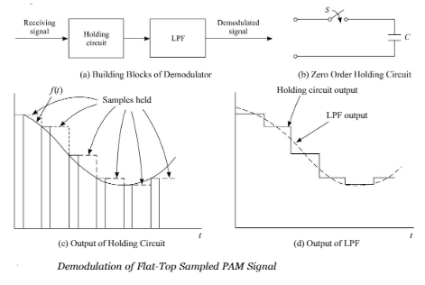
PAM Demodulation
Demodulation with Hold Circiut
The received signal is passed through a Holding circuit and a LPF
In the simple holding circuit, The switch S closes after the arrival of the pulse and it opens at the end of the pulse.
The capacitor C gets charged to the pulse amplitude value, and it holds this value during the interval between the two pulses.
The sampled value are shown in the figure c, The holding circuit output is smoothened in LPF as in figure d.
Some distortion is introduced because of the holding circuit(called zero order holding circuit), which considers only the previous sample to decide the value between the two pulses. As the order increases the distortion reduces.

Slide 11
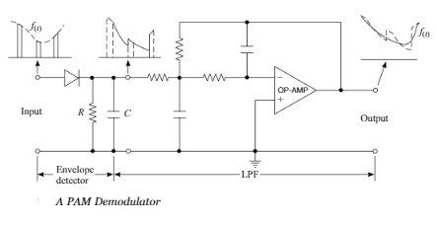
PAM Demodulation Circuit
PAM Demodulator
A Pam demodulator circuit is an envelope detector followed by a low Pass Filter.
The diode and RC combination work as the envelope detector, followed by a second order OP Amp low pass filter to have a good filtering characteristics.
Thus for the received pulse amplitude modulated signal as the input signal.
The desired demodulated signal (base band signal ) is shown in the output.

Slide 12
Advantages and Disadvantages of Pulse Amplitude Modulation
Advantages of Pulse Amplitude Modulation
PAM is the simplest form of pulse modulation.
Its implementation is quite easy.
Disadvantages of Pulse Amplitude Modulation
The transmission bandwidth required is very large.
Due to the variation in amplitude, the power required by the generating unit also varies.
Less immune to noise due to amplitude variation.
Applications of Pulse Amplitude Modulation
It is used in LED lighting, in microcontrollers in order to produce control signals and in the Ethernet communication system.

Slide 13
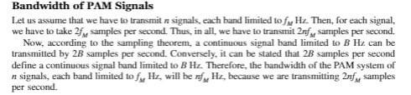
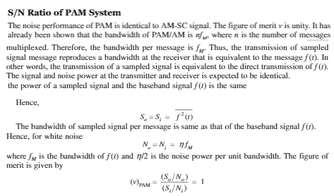

Slide 14
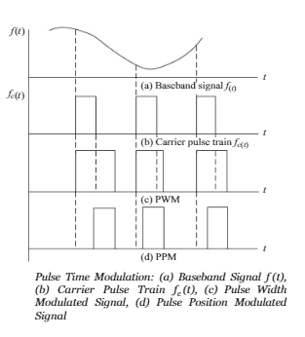
Pulse Time Modulation
Two Types of PTM systems , namely PWM(Pulse Width Modulation) and PPM(Pulse Position Modulation)
Pulse Time Modulation
In PWM signal , the width of each pulse depends on the instantaneous value of the baseband signal at the sampling instant.
In PPM signal where the shift in the position of each pulse depends on the instantaneous value of the base band signal at the sampling instant.
In PWM , the information about the baseband signal lies in the trailing edge of the pulse, whereas in PPM , it lies in both the edges of the pulse.
(Although, basically it lies in the leading edge, but since the width of the pulse is same always, the trailing edge also carries the same information)

Slide 15
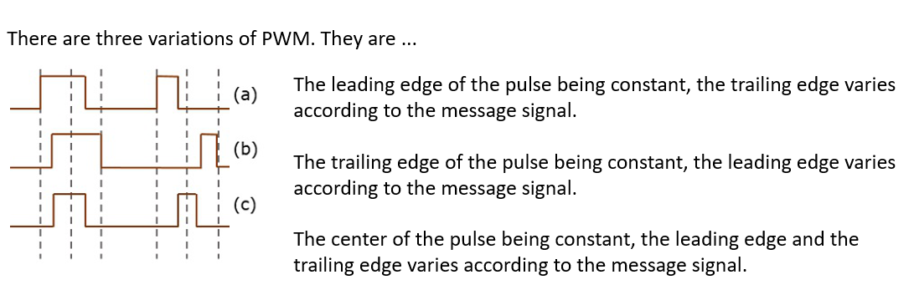
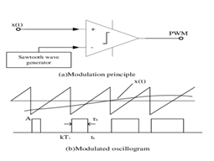
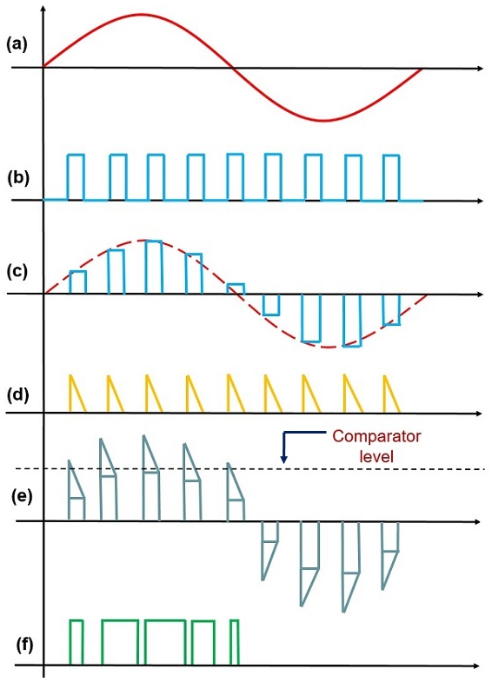
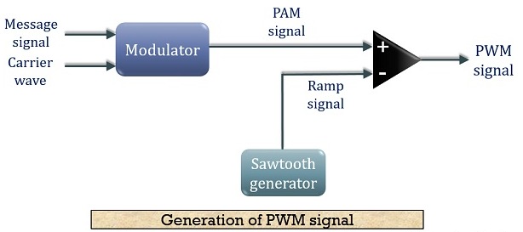
PWM Generation

Slide 16
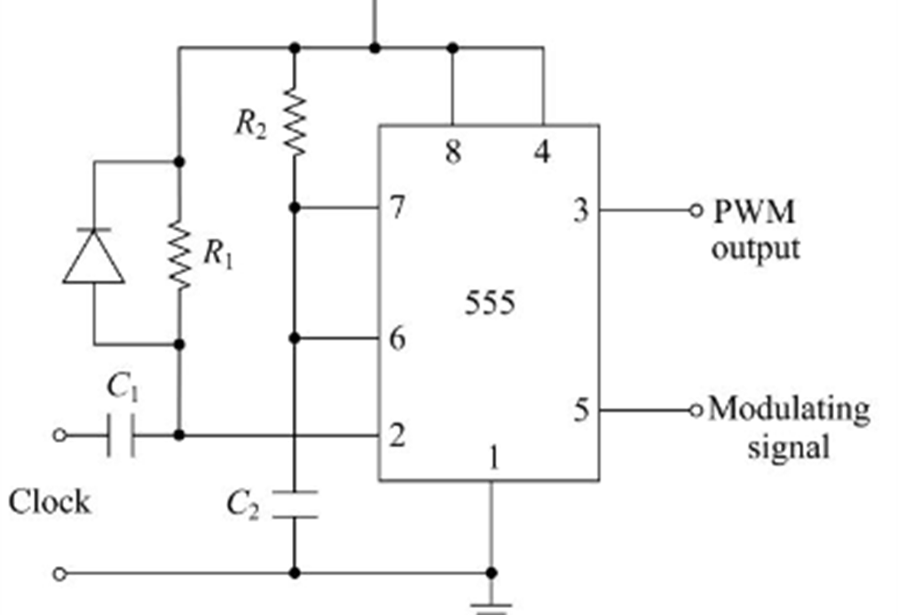
PWM Generation using 555Timer

Slide 17
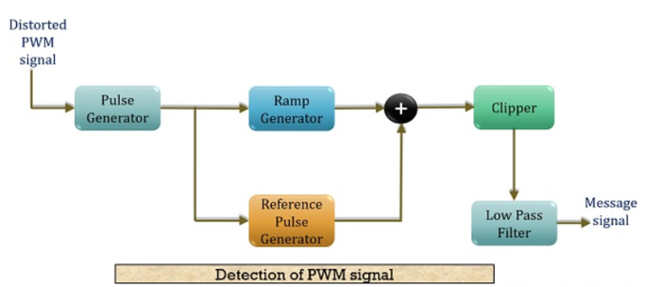
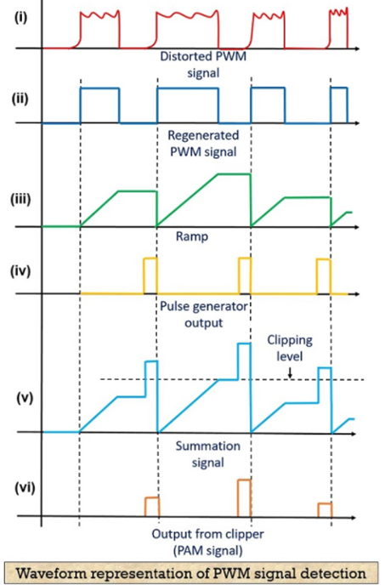
PWM Demodulation
The first image
shows the distorted PWM wave and the next one
shows the regenerated PWM pulse.
The operation of the ramp generator is shown in (iii) and
shows the output of the reference pulse generator. The summation operation and
clipping off the signal is shown in (v).
The final image of the figure (vi) represents the PAM pulses from which the original message signal is recovered.

Slide 18
Advantages and Disadvantages of Pulse Width Modulation
Advantages of Pulse Width Modulation
It is more immune to channel induced noise than PAM.
As noise adds to the amplitude thus the reconstruction of PWM signal from distorted PWM signal is somewhat easy.
The transmission and reception do not need to be synchronized.
Disadvantages of Pulse Width Modulation
Due to changing width of the pulses, variation in transmission power is also noticed.(requires large power transmission compared to PPM)
Bandwidth requirement in case of PWM is somewhat larger than PAM.
Applications of Pulse Width Modulation
It is used in telecommunications, brightness controlling of light or speed controlling of fans etc.

Slide 19
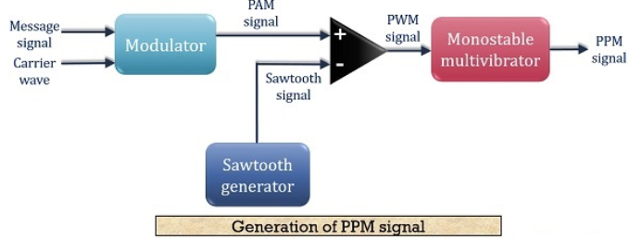
PPM Generation
By varying the position of the pulses (the carrier signal) in proportion to the instantaneous values of the analog signal (the message signal).
Pulse position modulation is done in accordance with the pulse width modulated signal.
Each trailing of the pulse width modulated signal becomes the starting point for pulses in the PPM signal.
Hence, the position of these pulses is proportional to the width of the PWM pulses.
But the main disadvantage of the PPM modulation technique is, The synchronization between transmitter and receiver must be needed.

Slide 20
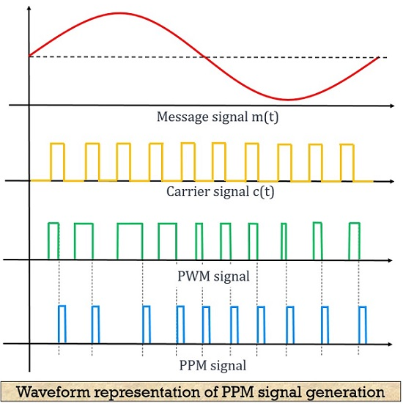
PPM Generation
By varying the position of the pulses (the carrier signal) in proportion to the instantaneous values of the analog signal (the message signal).
Pulse position modulation is done in accordance with the pulse width modulated signal.
Each trailing of the pulse width modulated signal becomes the starting point for pulses in the PPM signal.
Hence, the position of these pulses is proportional to the width of the PWM pulses.
But the main disadvantage of the PPM modulation technique is, The synchronization between transmitter and receiver must be needed.
Here,
the first image shows the modulating signal,
the second one shows a carrier signal.
The next one shows a PWM signal which is considered as reference for the generation of PPM
Note: In last figure , the Trailing ending of the PWM pulse and the (leading)beginning of PPM pulse is coinciding.

Slide 21
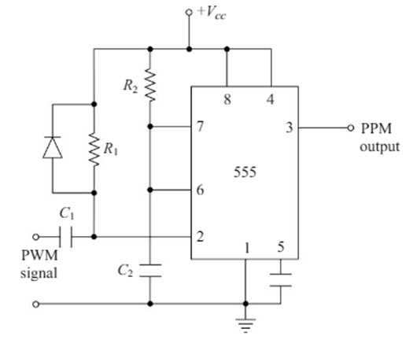
PPM Generation using Timer

Slide 22
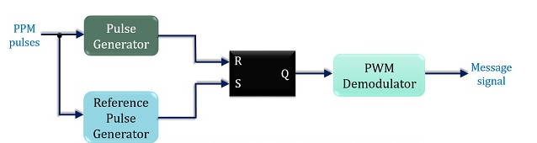
PPM Detector
By varying the position of the pulses (the carrier signal) in proportion to the instantaneous values of the analog signal (the message signal).
Pulse position modulation is done in accordance with the pulse width modulated signal.
Each trailing of the pulse width modulated signal becomes the starting point for pulses in the PPM signal.
Hence, the position of these pulses is proportional to the width of the PWM pulses.
But the main disadvantage of the PPM modulation technique is, The synchronization between transmitter and receiver must be needed.
The figure shows that the demodulation circuit consists of a pulse generator, SR flip-flop, reference pulse generator and a PWM demodulator.
The PPM signal transmitted from the modulation circuit gets distorted by the noise during transmission. This distorted PPM signal reaches the demodulator circuit. These set and reset signals generate a PWM signal at the output of the flip-flop. This PWM signal is then further processed in order to provide the original message signal.

Slide 23
Advantages and Disadvantages of Pulse Position Modulation
Advantages of Pulse Position Modulation
Similar to PWM, PPM also shows better noise immunity as compared to PAM. This is so because information content is present in the position of the pulses rather than amplitude.
As the amplitude and width of the pulses remain constant. Thus the transmission power also remains constant and does not show variation.
Recovering a PPM signal from distorted PPM is quite easy.
Interference due to noise in more minimal than PAM and PWM.
Disadvantages of Pulse Position Modulation
In order to have proper detection of the signal at the receiver, transmitter and receiver must be in synchronization.
The bandwidth requirement is large.
Applications of Pulse Position Modulation
The technique is used in an optical communication system, in radio control and in military applications.

Slide 24
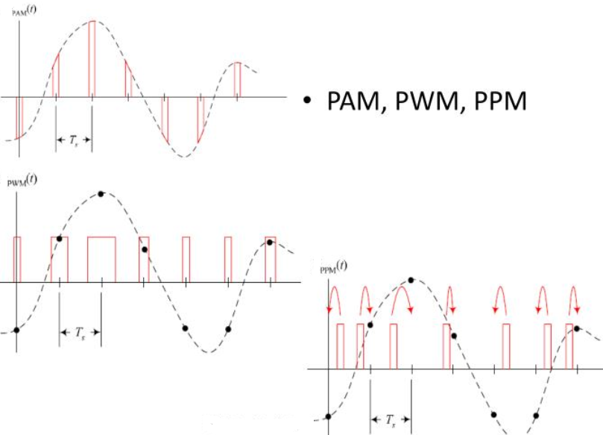
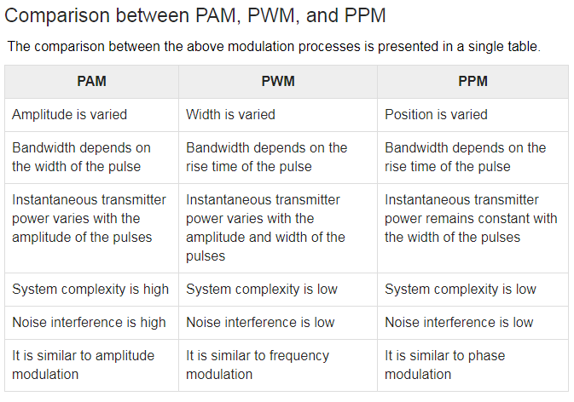

Slide 25
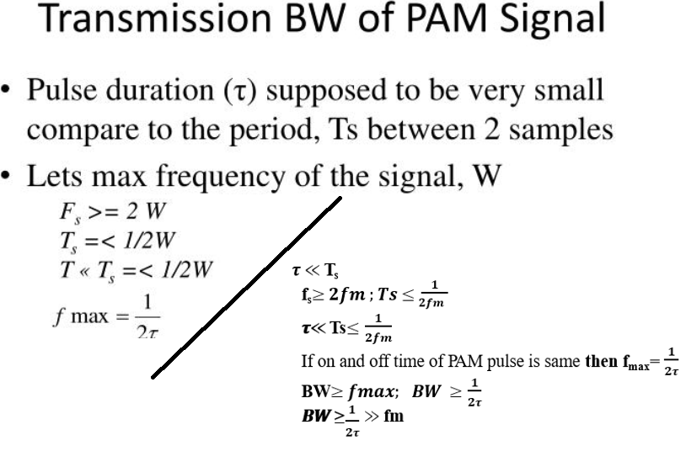
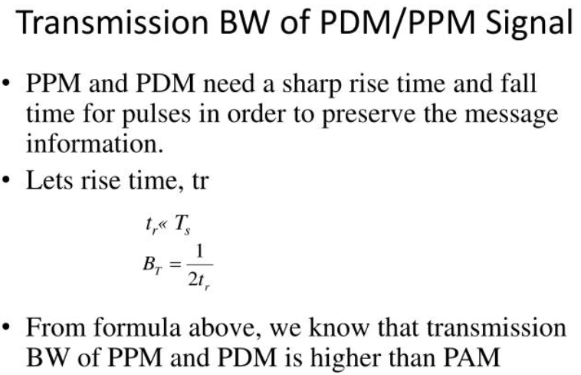

Slide 26
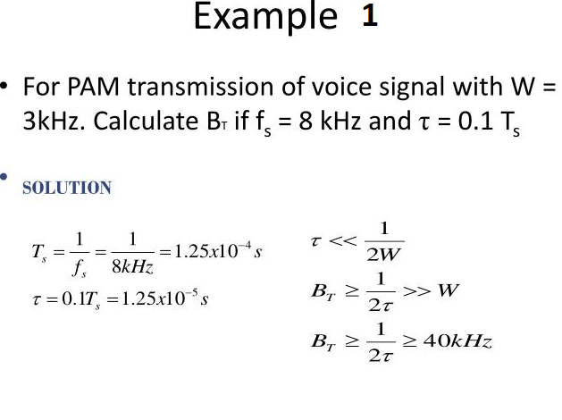
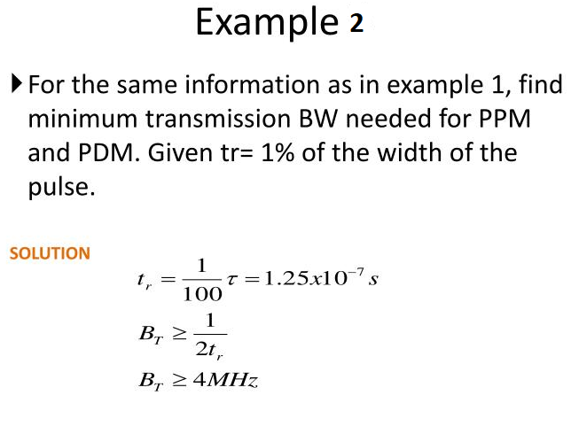

Slide 27
Pulse Code Modulation (PCM)
This type of modulation is different from all modulations learnt so far.
The signals here are sampled and sent in pulse form.
A common feature among other techniques is that pulse code modulation also uses sampling technique.
In this case, instead of sending a pulse train which is capable of continuously varying parameters, this type of generator produces a series of numbers or digits. Each digit in it represents the appropriate length of the sample at a particular instant.
The transmitter section of a Pulse Code Modulator circuit consists of Sampling, Quantizing and Encoding, which are performed in the analog-to-digital converter section. The low pass filter (anti-aliasing filter) prior to sampling prevents aliasing of the message signal.
The basic operations in the receiver section are regeneration of impaired signals, decoding, and reconstruction of the quantized pulse train. The following figure is the block diagram of PCM which represents the basic elements of both the transmitter and the receiver sections.

Slide 28
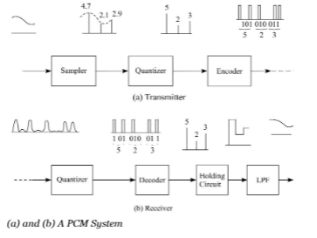
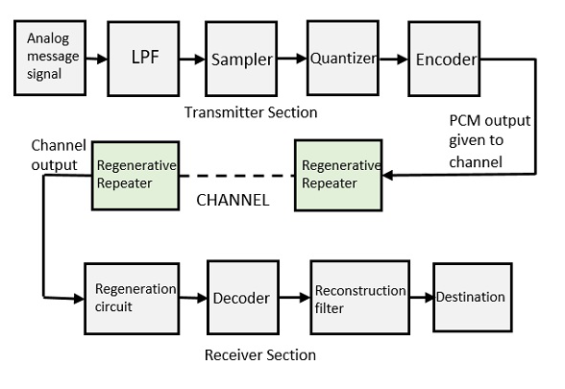
Block diagram of PCM

Slide 29
Low Pass Filter (LPF)
This filter eliminates the high frequency components present in the input analog signal which is greater than the highest frequency of the message signal, to avoid aliasing of the message signal.
Sampler
This is the circuit which uses the technique that helps to collect the sample data at instantaneous values of the message signal, so as to reconstruct the original signal. The sampling rate must be greater than twice the highest frequency component W of the message signal, in accordance with the sampling theorem.

Slide 30
Quantizer
Quantizing is a process of reducing the excessive bits and confining the data. The sampled output when given to Quantizer, reduces the redundant bits and compresses the value.
The digitization of analog signals involves the rounding off of the values which are approximately equal to the analog values. The method of sampling chooses few points on the analog signal and then these points are joined to round off the value to a near stabilized value. Such a process is called as Quantization.
The quantizing of an analog signal is done by discretizing the signal with a number of quantization levels. Quantization is representing the sampled values of the amplitude by a finite set of levels, which means converting a continuous-amplitude sample into a discrete-time signal.
As it basically rounds off the value to a certain level this shows some variation by the actual amount. Thus we can say, quantizing a signal introduces some distortion or noise into it. This is known as quantization error.
A quantizer can be of two types, uniform and non-uniform quantizer. In uniform quantizer, there exists a uniform spacing in between the level. As against, in non-uniform quantizer, the spacing in between the levels is not uniform. Here, we have employed a uniform quantizer.
For a low signal level, the quantization error is high i.e., bad SNR. But, for a high signal level, the quantization error is low providing good SNR.

Slide 31
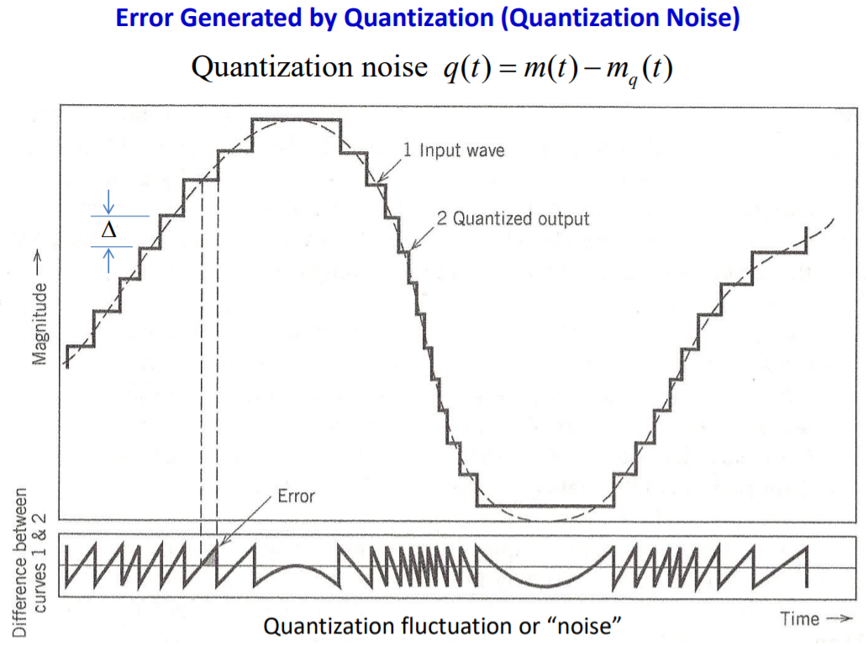
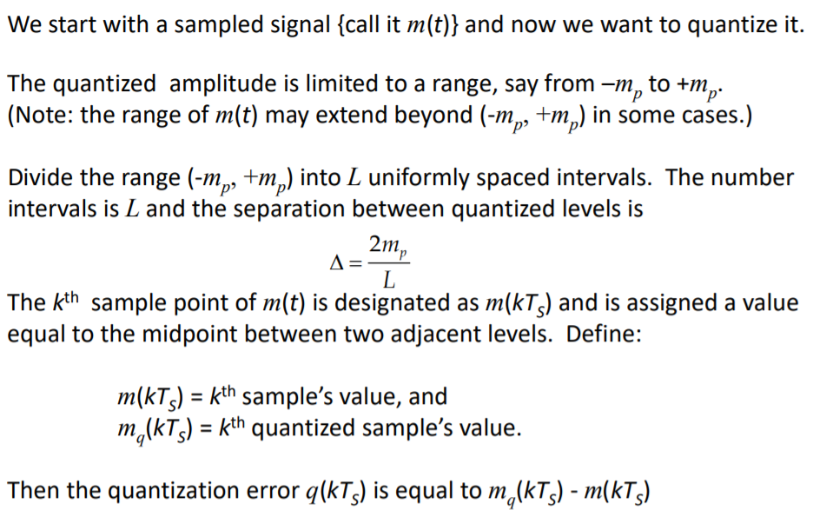
Both sampling and quantization results in the loss of information, aliasing and quantization error respectively.
The quality of a Quantizer output depends upon the number of quantization levels used.
The discrete amplitudes of the quantized output are called as representation levels or reconstruction levels.
The spacing between two adjacent representation levels is called a quantum or step-size.

Slide 32
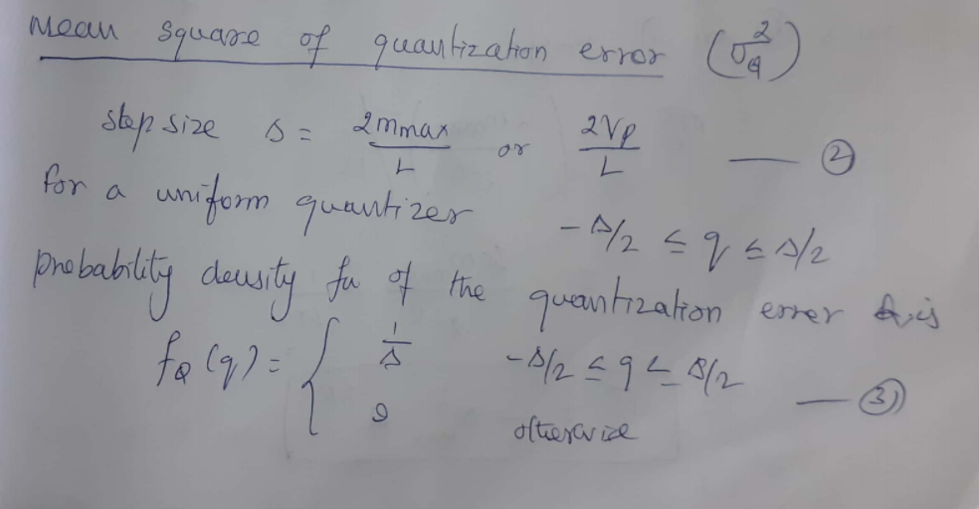
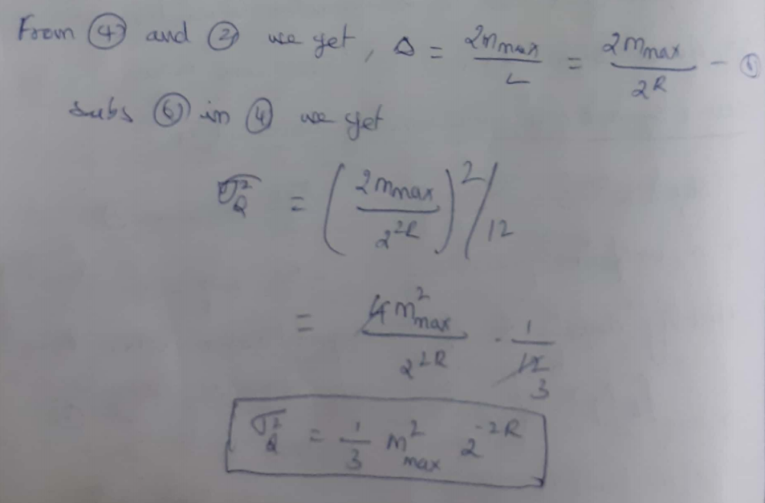
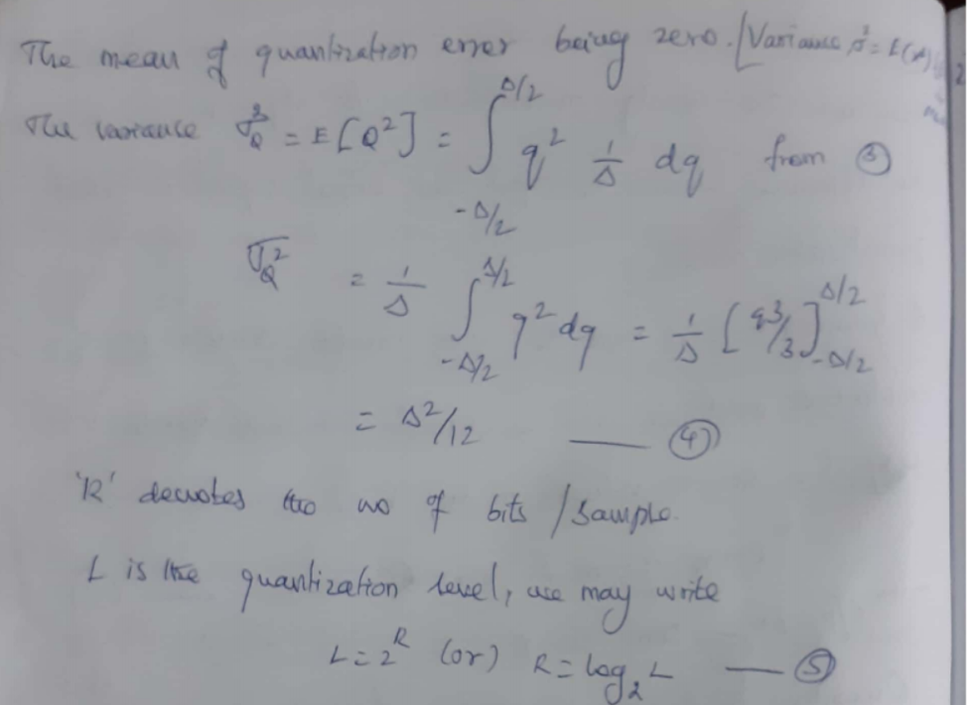

Slide 33
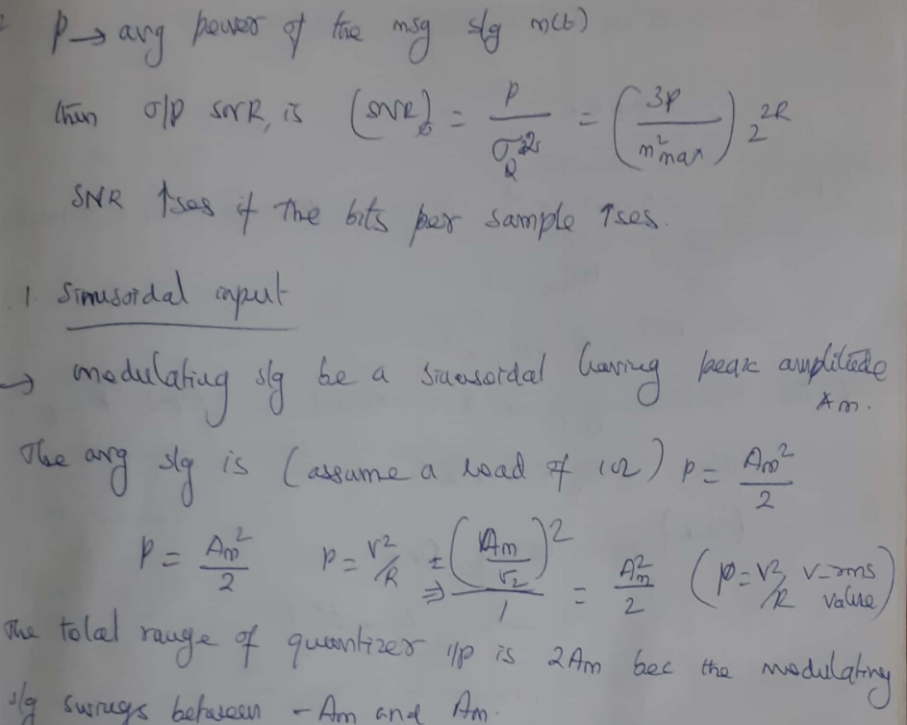

Slide 34
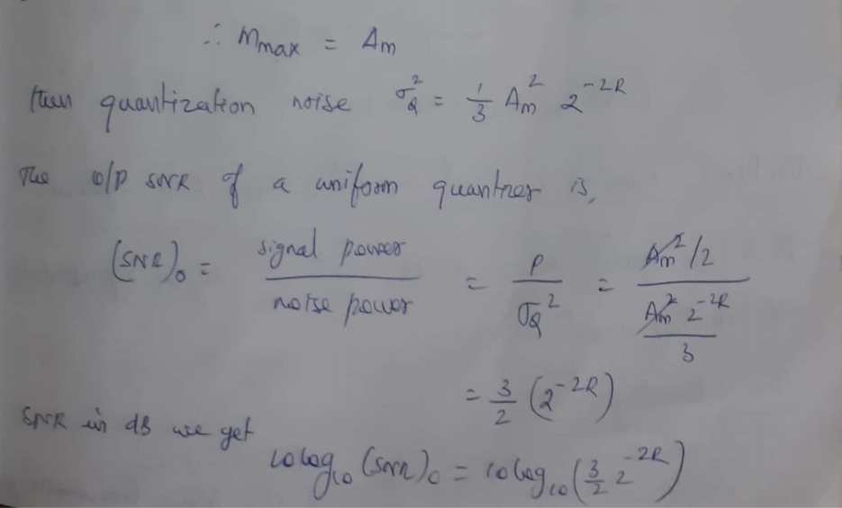
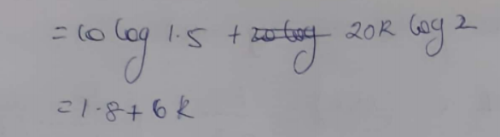

Slide 35
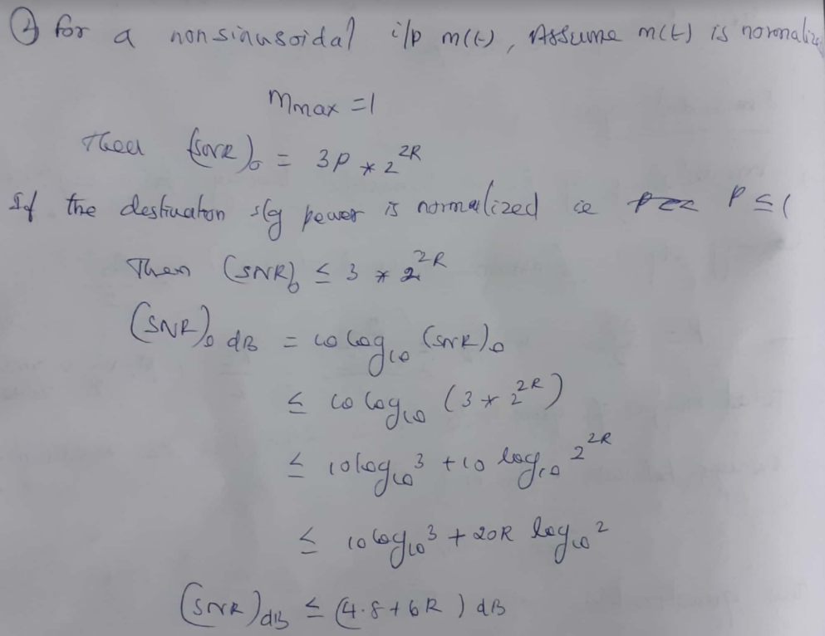

Slide 36
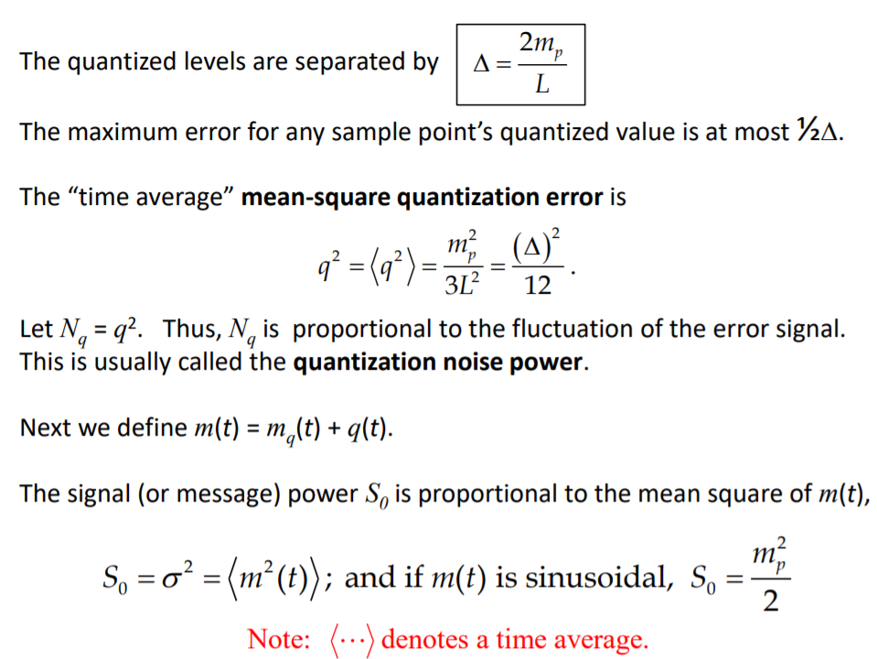
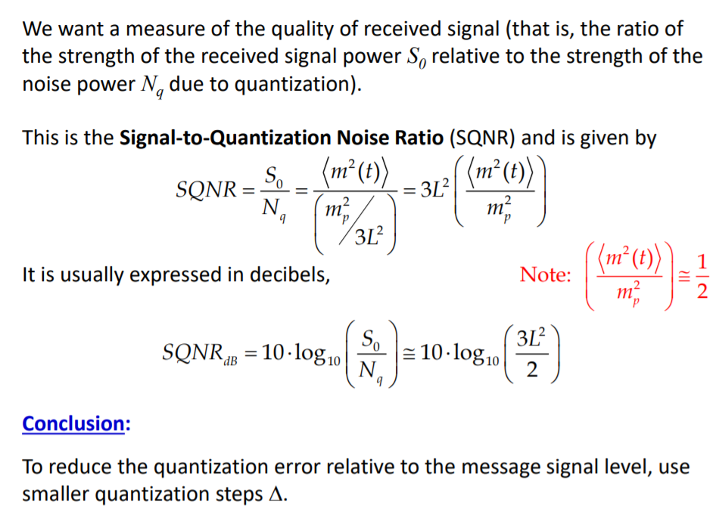

Slide 37
Encoder
The digitization of analog signal is done by the encoder. It designates each quantized level by a binary code. The sampling done here is the sample-and-hold process. These three sections will act as an analog to the digital converter. Encoding minimizes the bandwidth used.
To exploit the advantages of sampling and quantizing for the purpose of making the transmitted signal more robust to noise , interference and other channel impairments, we require the use of an encoding process to translate the discrete set of sample values to a more appropriate form of signal.
Plan for representing each of this discrete set of values as a particular arrangement of discrete event is called a code. One of the discrete event in a code is called code element or symbol.
A particular arrangement of symbols used in a code to represent a single value of a discrete set is called a code word or character.
Ina binary code , each symbol may be either of two distinct values , as presence or absence of a pulse(denoted as 1 and 0).
The maximum advantage over the effects of noise in a transmission medium is obtained by using a binary code , because of binary symbol withstands a relatively high level of noise and is easy to regenerate.

Slide 38
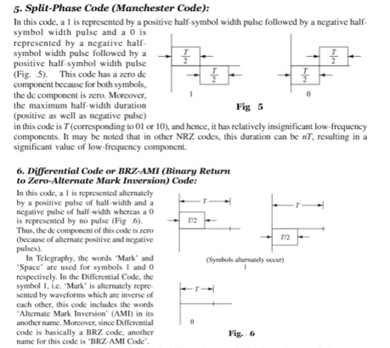
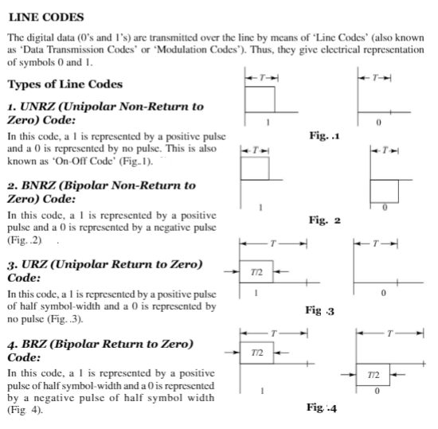
Line coding
Any of several line codes can be used for the electrical representation of binary data streams
On off signaling
Alternate mark inversion

Slide 39
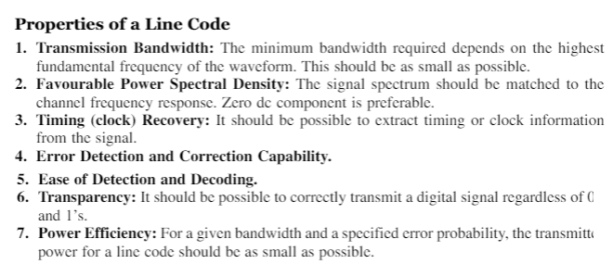
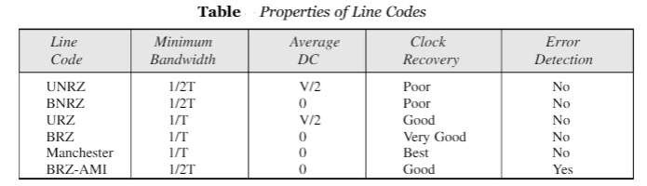
Line coding

Slide 40



Reconstruction Filter
After the digital-to-analog conversion is done by the regenerative circuit and the decoder, a low pass filter is employed, called as the reconstruction filter to get back the original signal.
Hence, the Pulse Code Modulator circuit digitizes the analog signal given, codes it, and samples it. It then transmits in an analog form. This whole process is repeated in a reverse pattern to obtain the original signal.
Regenerative Repeater
The output of the channel has one regenerative repeater circuit to compensate the signal loss and reconstruct the signal. It also increases the strength of the signal.
Decoder
The decoder circuit decodes the pulse coded waveform to reproduce the original signal. This circuit acts as the demodulator.

Slide 41

Problems exist in PCM

Slide 42

Companding in PCM
The word Companding is a combination of Compressing and Expanding, which means that it does both.
This is a non-linear technique used in PCM which compresses the data at the transmitter and expands the same data at the receiver to avoid signal distortion.
The effects of noise and crosstalk are reduced by using this technique.
There are two types of Companding techniques
A-law Companding Technique,
µ-law Companding Technique
A-law Companding Technique
Uniform quantization is achieved at A = 1, where the characteristic curve is linear and there is no compression.
A-law has mid-rise at the origin. Hence, it contains a non-zero value.
A-law companding is used for PCM telephone systems.
A-law is used in many parts of the world.
µ-law Companding Technique
Uniform quantization is achieved at µ = 0, where the characteristic curve is linear and there is no compression.
µ-law has mid-tread at the origin. Hence, it contains a zero value.
µ-law companding is used for speech and music signals.
µ-law is used in North America and Japan

Slide 43



Slide 44
Time-division multiplexing (TDM) is a method of transmitting and receiving independent signals over a common signal path by means of synchronized switches at each end of the transmission line so that each signal appears on the line only a fraction of time in an alternating pattern.
It is used when the data rate of the transmission medium exceeds that of signal to be transmitted.
When a large number of PCM signals are to be transmitted over a common channel, multiplexing of these PCM signals is required. There are two types of Multiplexing i)Synchronous TDM ii)Asynchronous TDM.
Multiplexing
Synchronous time division multiplexing
As in the case of PAM , TDM is possible in PCM also, Here each sample is coded into several bits. The multiplexing is possible in two ways.
i)Bits are taken , one by one from each channel sample code. After the first bits from all channel samples are taken , the commutator takes the second bits from all channel samples, and so on. This is bit interleaving.
ii)All code bits of the first channel samples are taken followed by all code bits of the second channel samples and so on. In this method, the desired commutator speed is less than the first method. This is word interleaving.
A synchronizing bit is added at the end of each frame of synchronization between the commutator and decommutator. All bits corresponding to a specific sample code from all channels constitute a frame. Thus if there are n channels and N bits per sample, then the size of a frame is nN bits. The signal that is to be time division multiplexed is bandlimited to the same frequency, resulting in the same sampling frequency for all channels and hence the Synchronous time division multiplexing.
Asynchronous time division multiplexing
When the signal to be time division multiplexed are bandlimited to different frequency, their sapling frequencies are also different, such asynchronously samples signals are multiplexed by a technique called Pulse stuffing.
Different signals are sampled at different sampling frequencies. The samples are stored on different storage device(elastic store). While transmitting these signals , each storage device is played at different speeds in such a way that the output sample rate of each device is same.
Pulse stuffing, often referred to as bit stuffing, is the practice of adding non-data bits to a binary signal before that signal is transmitted over a network. Pulse stuffing is often used as a means of controlling synchronization in systems that require both transmitter and receiver to transmit at the same bit rate.

Slide 45

PCM -TDM
This system is used to convey multiple signals over telephone lines using wideband coaxial cable.
Operation of the T1 system.
The operation of the PCM-TDM system is as follows
This system has been designed to accommodate 24 voice channels marked S1 to S24 .
Each signal is bandlimited to 3.3kHz, and the sampling is done at a standard rate of 8 kHz.
This is higher than the Nyquist rate.
The sampling is done by the commutator switch SW1 .
These voice signals are selected one by one and connected to a PCM transmitter by the commutator switch SW1.
Each sampled signal is then applied to the PCM transmitter which converts it into a digital signal by the process of A to D conversion and companding, as explained earlier.
The resulting digital waveform is transmitted over a co-axial cable.
Periodically, after every 6000 ft, the PCM-TDM signal is regenerated by amplifiers called “repeaters”.
They eliminate the distortion introduced by the channel and remove the superimposed noise and regenerate a clean PCM-TDM signal at their output.
This ensures that the received signal is free from the distortions and noise.
At the destination the signal is companded, decoded and demultiplexed, using a PCM receiver.
The PCM receiver output is connected to different low pass filters via commutator switch SW2 .
Synchronization between the transmitter and receiver commutators SW1 and SW2 is essential in
order to ensure proper communication.

Slide 46

Bandwidth of a PCM
Bandwidth of PCM signal depends on the bit rate and the pulse shape.
Let the bit rate be R (of the PCM signal generated), then
R = n*fs
n = number of bits on the PCM word (M= 2^n …. M is no. of levels of quantization)
fs = sampling rate to which analog signal is sampled
For no aliasing i.e. the Nyquist rate : fs= 2fm,
where fm is the bandwidth of the analog signal that is to be converted.
Bandwidth of the PCM (BPCM) waveform is bounded by
BPCM>= R/2
BPCM>= n* fm
(so R/2 is the minimum bandwidth of the PCM signal)
For one using a rectangular pulse with polar NRZ (Non return to zero) line code:
BPCM = R = n*fs = n*2*B
This means the bandwidth of PCM is greater than the bandwidth of the analog signal.

Slide 47



Slide 48
Benefits or advantages of PCM: ➨It is robust against noise and interference. ➨Uniform transmission quality. ➨Efficient SNR and bandwidth trade off. ➨It provides secure data transmission. ➨It offers efficient regeneration. ➨It is easy to add or drop channels
➨ The PCM signal can then be transmitted over long distance with great reliability.
Limitations/drawbacks or disadvantages of PCM: ➨Overload appears when modulating signal changes between samplings, by an amount greater than the size of the step. ➨Large bandwidth is required for transmission. ➨Noise and crosstalk leaves low but rises attenuation. ➨An IDN (Integrated Digital Network) can only be realized by gradual extension of noise. ➨The difference between original analog signal and translated digital signal is called quantizing error.
➨ Requires synchronization between receiver and transmitter.

Slide 49

Problems
Estimate the number of levels if the number of bits per sample is as follows.
(a) 8 (as in telephony)
(b) 16 (as in compact disc audio systems)
Solution :
a) The number of levels with 8 bits per sample
N = 2^{m,}
^{m} = 28
Therefore N= 256
b) The number of levels with 16 bits per sample
N = 2^{m}
^{m} = 216
Therefore N= 65,536.

Slide 50


Problems

Slide 51


Problems

Slide 52

Data formatting

Slide 53
Line codes can be used for the electrical representation of a binary data stream. The different types of line codes are
1. NRZ – Non-return to Zero
2. RZ -Return to Zero
3. Phase encoded group
1.NRZ
Most commonly used PCM waveform . It can be partitioned into the following subgroups.
a. NRZ-L (L for level)
b. NRZ-M (M for mark)
c. NRZ-S (S for space)
a. NRZ-L
If symbol ‘1’ is transmitted, x(t)=+V for 0≤t ≤ T
If symbol ‘0’ is transmitted, x(t)=-V for 0≤t ≤ T
b. NRZ-M
If symbol ‘1’ is transmitted , one or mark is represented by a change in level.
If symbol ‘0’ is transmitted , zero or space is represented by no change in level.

Slide 54
c. NRZ-S
It is the complement of NRZ-M
In NRZ-S, one is represented by no change in level
and zero is represented by a change in level.
2.Return to Zero (RZ)
The RZ waveform consists of
a. Unipolar RZ
b. Bipolar RZ
c. RZ-AMI
These codes find applications in base data transmission and in magnetic recording.
a.Unipolar RZ
If symbol ‘1’ is transmitted, x(t)=+V for 0≤t ≤ T/2
= 0 for T/2≤t ≤ T
If symbol ‘0’ is transmitted, x(t)=0 for 0≤t ≤ T

Slide 55
b.Bipolar RZ
If symbol ‘1’ is transmitted, x(t)=+V for 0≤t ≤ T/2
= 0 for T/2≤t ≤ T
If symbol ‘0’ is transmitted, x(t)=-V for 0≤t ≤ T/2
= 0 for T/2≤t ≤ T
c.RZ-AMI
AMI – Alternate Mark Inversion.
The ones are represented by equal amplitude alternating pulses
The zeros are represented by the absence of pulses.
3.Phase encoded group
It consists of
a. Bi-ø-L (Bi phase Level /Manchester coding)
b. Bi-ø-M (Bi phase Mark)
c. Bi-ø-S (Bi phase Space)

Slide 56
a.Bi-ø-L
If symbol ‘1’ is to be transmitted (positive half interval pulse is followed by a negative half interval pulse)
x(t)= +V for 0≤t ≤ T/2
= -V for T/2≤t ≤ T
If symbol ‘0’ is to be transmitted (negative half interval pulse is followed by a positive half interval pulse)
x(t)= -V for 0≤t ≤ T/2
= +V for T/2≤t ≤ T
b.Bi-ø-M
A transition occurs at the beginning of every bit interval.
Symbol ‘1’ is represented by a second transition one half bit interval later.
Symbol ‘0’ is represented by no second transition but there is a transition in the beginning of the bit interval.

Slide 57

c.Bi-ø-S
A transition occurs at the beginning of every bit interval.
Symbol ‘1’ is represented by no second transition.
Symbol ‘0’ is represented by a second transition one half bit interval later.
Differential encoding
It is used to encode information in terms of signal transition.
A transition is used to designate symbol ‘o’ while no transition is used to designate symbol ‘1’.

Slide 58
The original binary information is recovered by comparing the polarity of adjacent binary symbols to establish whether or not a transition has occurred.
It requires the use of reference bit before initiating the encoding process.
Here , symbol ‘1’ is used as the reference bit.

Slide 59
Differential Pulse Code Modulation (DPCM)
DPCM is a technique in which the difference between the samples, rather than the sample values themselves, is encoded in binary.
The reason for employing DPCM is that speech samples do not change drastically from sample to sample and therefore the difference values can be encoded using fewer bits.

Slide 60


Slide 61



Suppose a baseband signal m(t) is sampled at the rate fs=1/Ts to produce the sequence {m(nT)} where samples are Ts seconds apart.
The input signal to the quantizer is defined as,
------------- (1)
where m[n]- input sample (unquantized)
- predicted sample
The predicted value is produced by using a linear prediction filter whose input is quantized version of the input sample m[n].
The difference signal is the prediction error e[nT].It is the amount by which the prediction filter fails to predict the input exactly.
----------- (2)
where q[n] – quantization error

Slide 62







The quantizer output is added to the predicted value to produce the prediction filter output.
-------------- (3)
substituting equation (2) into (3) , we get
The sum of is equal to input sample m[n]. Therefore we may simplify the above equation as
- represents quantized version of the input sample m[n]. ie, irrespective of the properties of the prediction filter the quantized

Slide 63
sample at the prediction filter output differs from the original sample m[n] by the quantizer error q[n].
The receiver consists of a decoder to reconstruct the quantized error signal.
The quantized version of original input is reconstructed from the decoder output using the same prediction filter used in transmitter.
In the absence of channel noise, the encoded signal at the receiver input is identical to the encoded signal at the transmitter output.
Accordingly the corresponding receiver output is equal to , which differs from the original input m[n] only by q[n].
The feedback path added to the quantizer in the transmitter results in the prediction filter in the transmitter and receiver operate in the same sequence of samples in a noise-free environment .

Slide 64






Processing Gain
The output signal to noise ratio of the DPCM signal is given by,
----- (4)
We may rewrite the equation (4) as the product of two factor
and the Processing Gain is,

Slide 65

Delta Modulation (DM)
The delta modulation is a special case of DPCM.
DM is 1-bit version of DPCM.
In DM, an incoming message signal is oversampled to increase the correlation between adjacent samples of the signal.
It provides the staircase approximation to the oversampled version of the message signal.
The difference between the input and the approximation is quantized into only two levels , corresponding to positive and negative differences.
If the approximation falls below the signal at any sampling epoch, it is increased by
If the approximation lies above the signal ,it is decreased by

Slide 66

If there is no rapid change from sample to sample, then the stair-case approximation remains within of the input signal.
The staircase approximation mq(t) follows variations in the input signal m(t).

Slide 67


Slide 68




Let m(t) – input message signal ,mq(t) – its staircase approximation
m[n] –sequence of samples
m[nTs]- sample of m[t] taken at time t=nTs , where Ts is sampling period.
we have,
where
e[n] – error signal representing the difference between the present sample m[n] of the input signal and the latest approximation mq[n-1]
– quantized version of e(n)
sgn(.) –signum function
The quantizer output is coded to produce the DM signal.

Slide 69

The rate of information transmission is equal to the sampling rate fs=1/Ts.
The delta modulated wave is generated by applying the sampled version of the incoming message signal to a modulator that involves a comparator , quantizer and accumulator.
z⁻¹ is unit delay.
The comparator computes the difference between its two inputs . The quantizer consists of hard limiter with an input-output relation that is scaled version of the signum function . Then the quantizer output is applied to the accumulator, producing the result,

Slide 70
Thus, at the sampling instant nTs, the accumulator increments the approximation by a step in a positive or negative direction, depending on the sign of the error signal e[n].
If the input sample m[n] is greater than the most recent approximation mq[n] , a positive increment + is applied to the approximation.
If the input sample is smaller, a negative increment - is applied to the approximation.
In the receiver, the staircase approximation mq(t) is reconstructed by passing the sequence of positive and negative pulses, produced at the
decoder output, through an accumulator. The quantization noise in staircase waveform mq(t) is rejected by passing it through a LPF.

Slide 71

Noise in Delta modulation
Delta modulation subject to two types of quantization error.
a. Slope overload distortion b. Granular noise

Slide 72



The quantization error by q[n] is
The input to the quantizer is ,
Thus except for the quantization error q[n-1], the quantizer input is a first backward difference of the input signal.
If we consider the maximum slope of the original input waveform m(t), it is clear that in order for the sequence of samples m[n] in a region of maximum slope of m(t),
we require that the condition be satisfied.
Slope-overload distortion : It occurs when the step size is too small for the staircase approximation mq(t) to follow a steep segment of the input waveform m(t), with the result that mq(t) falls behind m(t). This condition is called slope overload and the resulting quantization error is called slope-overload distortion(noise).

Slide 73
Since the maximum slope of the staircase approximation mq(t) is fixed by the step size , increases and decreases in mq(t) tend to occur along the straight lines. For this reason, a delta modulator using a fixed step size is often referred to as a linear delta modulator.
Granular noise: It occurs when the step size is too large relative to the slope characteristics of the input waveform m(t), thereby causing the staircase approximation mq(t) to hunt around a relatively flat segment of the input waveform . It is analogous to quantization noise in a PCM system.

